Slide 1
Hr and Br tag

Slide 2
Agenda
Hr and Br tag
Sample output
Hr and Br tag implementation

Slide 3
Hr and Br tag
Hr Tag
Used to draw line where needed in the web page.
Syntax:
<hr> </hr> or
<hr> or
<hr />
Br Tag
Used to go to next line or break sentence in a paragraph.
Syntax:
<br> or
<br />

Slide 4
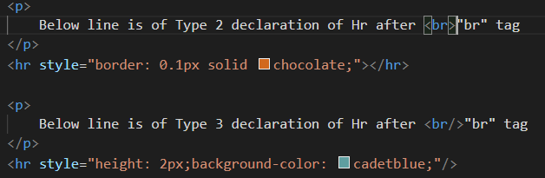
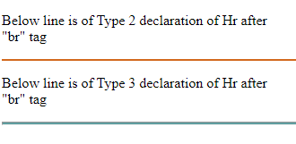
Sample output

Slide 5
Hr and Br tag implementation
Let’s see hr and br tag implementation.

Slide 6
Summary
Hr is used to draw line.
Br is used to break line or move to next line.
DO NOT WRITE ANYTHING
HERE. LEAVE THIS SPACE FOR
WEBCAM

Slide 7
Thank You
Proprietary content. ©Great Learning. All Rights Reserved. Unauthorized use or distribution prohibited

